Slide 1


Oleh
29.07.2024

Slide 2

Outline
Executive Summary
Introduction
Methodology
Results
Conclusion
Appendix

Slide 3
Executive Summary
Summary of methodologies
Data Collection: SpaceX API and Web Scraping
Data Wrangling
Exploratory Data Analysis with Visualizations and SQL
Interactive Map with Folium
Interactive Dashboard with Plotly|Dash
Predictive Analysis
Summary of all results

Slide 4
Introduction
Many companies provide space travels like Virgin Galactic, Rocket Lab, Blue Origin, and Space X.
SpaceX is the most successful and it has the advantage that the first stage of the Falcon 9 rocket is reusable
The cost of a launch is 62 million dollars, while other providers cost upwards of 165 million dollars each
The lower cost is largely due to the reusability of the first stage
Knowing the key factors which will guarantee a successful Landing of the first stage is crucial
This in turn will impact on the overall average cost for each Launch

Slide 5

Section 1

Slide 6
Methodology
Executive Summary
Data collection methodology:
SpaceX API and WebScaraping
Perform data wrangling
Looking for null values, identifying categorical columns, on-hot encoding, ...
Perform exploratory data analysis (EDA) using visualization and SQL
Perform interactive visual analytics using Folium and Plotly Dash
Perform predictive analysis using classification models
Linear Multiple Regression, SVM, Classification Tree, and KNN models are trained and evaluated

Slide 7
Data Collection
Data are collected with two methods as schematically shown below
Further details are in the folowing slides
SapceX API
JSON to DataFrame
SAVE in .csv format
Web Scraping from Wikipedia
BeautifulSoup to DataFrame
SAVE in .csv format

Slide 8
Data Collection – SpaceX API
https://api.spacexdata.com/v4/
The SpaceX REST API is called several times with different parameters in order to get the right data in JSON format
Data are converted into lists and then into a pandas Data Frame
The parameters and the respective data are schematically shown in the right chart
From the collected data only Falcon 9 rows are filtered and the resulting Data Frame is exported to a .csv file.
core
outcome of the landing
rockets
Booster name
launchpads
Name of the launch site
Longitude and Latitude
payloads
Orbit name
Mass of the payload
type of the landing
number of flights with a core
etc.
launches/past
rocket
flight_number
payloads
launchpad
cores
date_utc
https://github.com/4ipsyki/SpaceY/blob/main/01%20-%20jupyter-labs-spacex-data-collection-api.ipynb

Slide 9
Data Collection - Scraping
https://github.com/4ipsyki/SpaceY/blob/main/02%20-%20jupyter-labs-webscraping.ipynb
Data are found in tables on Wikipedia: https://en.wikipedia.org/wiki/List_of_Falcon_9_and_Falcon_Heavy_launches
BeautifulSoup is used to extract the column names
Data are extracted looping through the elements of each row of each table
response.get call
Creating of a BeautifulSoup object
Extracting columns name from the header by searching the "th" element
Looping through each cell ("td" elemnt) in each row ("tr" elemnt) the date are extracted into a dictionary
Data are then converted into a DataFrame and exported as a .csv file
https://github.com/4ipsyki/SpaceY/blob/main/02%20-%20jupyter-labs-webscraping.ipynb

Slide 10
Data Wrangling
Loading data into a DataFrame object
Identifying the null values
Looking for orbit type
Looking for landing outcomes
Categorizing outcomes as a boolean column "Classs"
Identifying numerical and categorical columns
Looking for launch sites
The mean landing outcome is Successful for 66.67 % of the cases
https://github.com/4ipsyki/SpaceY/blob/main/03%20-%20labs-jupyter-spacex-Data%20wrangling.ipynb

Slide 11
EDA with Data Visualization
The following plots were performed in order to identify preliminarily how the features influence the Class (Outcome):
Scatter - FlightNumber vs. PayloadMass color-coded with Class
Scatter - FlightNumber vs. LaunchSite color-coded with Class
Scatter - PayloadMass vs. LaunchSite color-coded with Class
Bar - Orbit Type vs. Success Rate
Scatter - FlightNumber vs. Orbit Type color-coded with Class
Scatter - PayloadMass vs. Orbit Type color-coded with Class
Line - Year vs. Success Rate
As the last step, the categorical data were one-hot encoded into floats
https://github.com/4ipsyki/SpaceY/blob/main/05%20-%20jupyter-labs-eda-dataviz.ipynb

Slide 12
EDA with SQL
The data are loaded into a DataFrame object and converted into a DataBase.
The following sql queries were performed:
Display the names of the unique launch sites in the space mission
Display 5 records where launch sites begin with the string 'CCA'
Display the total payload mass carried by boosters launched by NASA (CRS)
Display average payload mass carried by booster version F9 v1.1
List the date when the first successful landing outcome in ground pad was achieved
List the names of the boosters which have success in drone ship and have payload mass greater than 4000 but less than 6000
List the total number of successful and failure mission outcomes
List the names of the booster_versions which have carried the maximum payload mass
List the records which will display the month names, failure landing_outcomes in drone ship ,booster versions, launch_site for the months in year 2015
Rank the count of landing outcomes between the date 2010-06-04 and 2017-03-20, in descending order
https://github.com/4ipsyki/SpaceY/blob/main/04%20-%20jupyter-labs-eda-sql-coursera_sqllite.ipynb

Slide 13
Build an Interactive Map with Folium
Each distinct Launch Site was marked on a Folium Map plot with a red Circle and the corresponding label
This is to understand the geographical locations of the launch sites
For each record a Green (Successful Landing) and Red (Unsuccessful) Marker was added onto the map within a MarkerCluster object for a better visualization
This is to visually inspect how successful are each of the launch sites
For a selected Launch Site, distances to the coastline, railroad, nearby city and highway were calculated and displayed on the map with a line and a label
This is to understand how close are the launch sites to public places and infrastructure
https://github.com/4ipsyki/SpaceY/blob/main/06%20-%20lab_jupyter_launch_site_location.ipynb

Slide 14
Build a Dashboard with Plotly Dash
The following plots and features are created in the Dashboard:
Success Rate vs. Launch Site discernable for Launch Site through a DropDown
PayloadMass vs. Class color-coded for BoosterVersion and PayloadMass-windowed through a Slider
The second plot is also connected to the DropDown menu, thus allowing a better understanding of how the Class (Success Rate) is correlated with the considered features.
https://github.com/4ipsyki/SpaceY/blob/main/07%20-%20spacex_dash_app.py

Slide 15
Predictive Analysis (Classification)
The following Model are used:
Linear Multiple Regression
SVM
Classification Tree
K-Nearest Neighbour
Each model is trained on the Train set and evaluated on the Test set with metrices such as Accuracy and Confusion Matrix
Class converted into a Numpy Array Y
Features are Contained inside a DataFrame object X
X columns are standardized with SdandardScaler() from sklearn
X and Y are split into train/test sets as 80/20
Mutliple models are trainde and tested
The results are summarized with the respective metrices
https://github.com/4ipsyki/SpaceY/blob/main/08%20-%20SpaceX_Machine_Learning_Prediction_Part_5.jupyterlite.ipynb

Slide 16
Results
CCAFS SLC 40 Launch Site is the most used, while KSC LC-39A is the most Successful for Landing
Success Rate is increased for Launches with a Payload of more than 10000 kg
SSO Orbit Type has 100% Success Rate
After 2013 the Success Rate shows a steep improvement, with 2019 as the best year
with about 90 %
Interactive analytics as Folium Map and Dashboard can be used to explore the data
Predictive analysis shows that Classification Tree is the best model
The main problem with predictive analytics is the inability to considerably improve the True Negatives
True Positives are predicted correctly with all the four models

Slide 17

Section 2

Slide 18
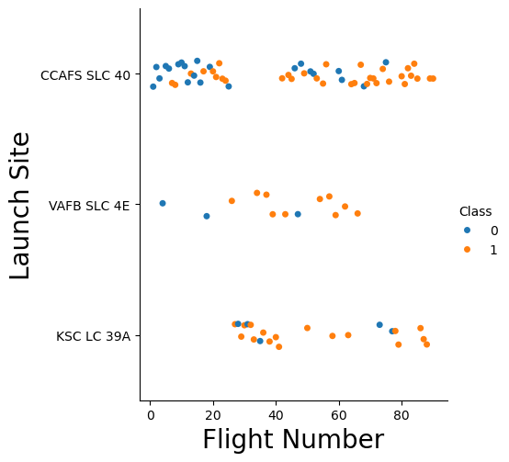
Flight Number vs. Launch Site
There is a considerable preference for CCAFS SLC 40 Launch Site as compared to others
This Launch site is especially predominant for about the first 20 launches where the majority of Unsuccessful landings have been obtained

Slide 19
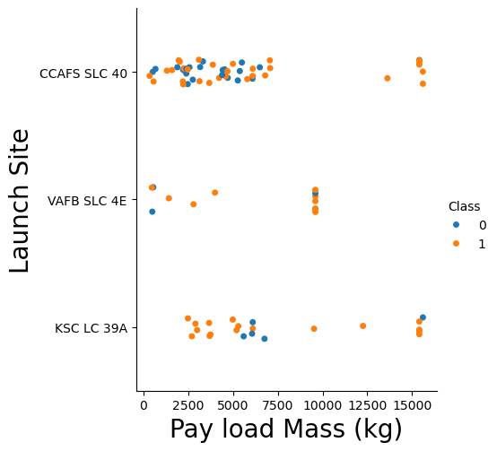
Payload vs. Launch Site
The majority of Unsuccessful landings are obtained with a Payload below 7500 kg
For Payloads of more than 10000 kg, the Success rate is greatly increased for the three Launch sites

Slide 20
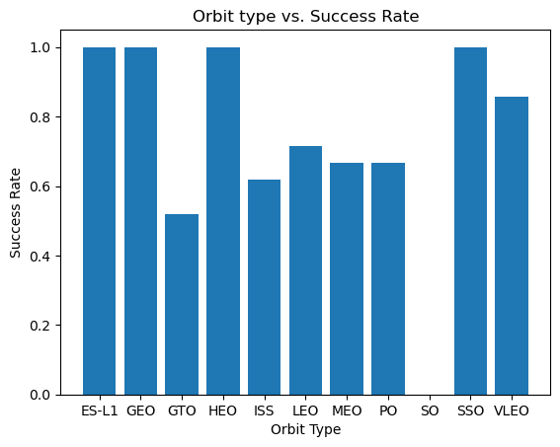
Success Rate vs. Orbit Type
Four orbit types have a Succes rate of 100 %: ES-L1, GEO, HEO, and SSO
Followed is VLEO with more than 80 %
Five orbit types are between 50 and 70 %: ISS, LEO, MEO, PO, and GTO
SO Orbit type is the most unsuccessful with 0 %

Slide 21
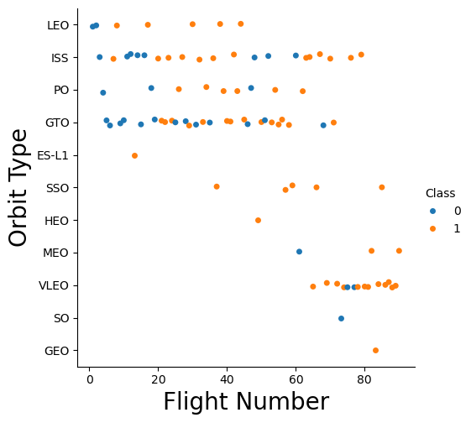
Flight Number vs. Orbit Type
The SO, ES-L1, and GEO orbit types have been chosen only once, so the data are not representative
Only ISS, PO, and GTO orbit types were chosen on a regular basis
GTO orbit is the most frequent and thus has more unsuccessful landings
SSO orbit type with five launches is the most successful

Slide 22
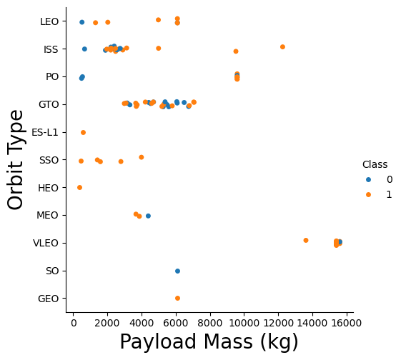
Payload vs. Orbit Type
Contrary to slide 19 observations, the most successful type of orbit (SSO) was adopted with low PayloadMass
The GTO orbit type is used for payloads between 3000 and 8000 kg and represents the most unsuccessful landings

Slide 23
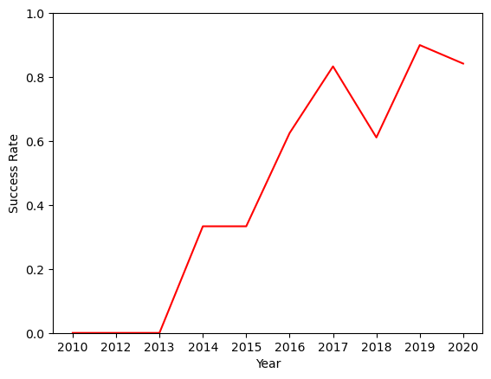
Launch Success Yearly Trend
Up to 2013 (for three years) the landings were unsuccessful
In 2014 and 2015 the success was stable below 40%
Up to 2017 the success was linearly growing
The best year was in 2019 with about 90 %
In 2018 there is a dip with a value similar to 2016

Slide 24
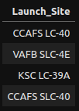
All Launch Site Names
Launch Sites are extracted with an sql query by adopting the DISTINCT function
It is found that there are only four Launch Sites

Slide 25
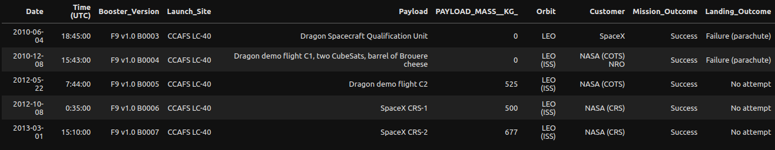
Launch Site Names Begin with 'CCA'
The first five records where launch sites begin with `CCA` are shown below
One can see that although the Landings were unsuccessful, the missions were successful

Slide 26
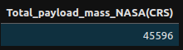
Total Payload Mass
The total payload carried by boosters from NASA is 45'596 kg
The result is found by filtering the proper rows and using the SUM function for the calculation

Slide 27
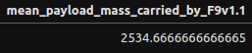
Average Payload Mass by F9 v1.1
The average payload mass carried by booster version F9 v1.1 is found to be 2534.67 kg
The result is found by filtering the proper rows and using the AVG function for the calculation

Slide 28

First Successful Ground Landing Date
The date of the first successful landing on ground pad is on 22 Dec 2015

Slide 29
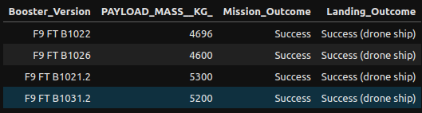
Successful Drone Ship Landing with Payload between 4000 and 6000
Here is the list of the names of boosters which have successfully landed on drone ship and had payload mass greater than 4000 but less than 6000
The booster versions are all of F9 FT type

Slide 30
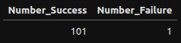
Total Number of Successful and Failure Mission Outcomes
Although there is a considerable amount of unsuccessful landings, we can clearly see that almost all of them were programmed
Only one mission was Unsuccessful

Slide 31
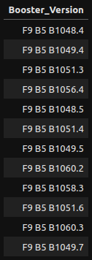
Boosters Carried Maximum Payload
The names of the distinct boosters that have been used to carry the maximum payload mass are listed here
One can see that all of them are of F9 B5 type

Slide 32
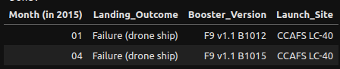
2015 Launch Records
The are two failed landing_outcomes in drone ship in year 2015
One can see that they are three months apart and have the same BoosterVersion and LaunchSite

Slide 33
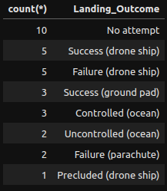
Rank Landing Outcomes Between 2010-06-04 and 2017-03-20
The most unsuccessful landing outcomes were the once where a landing was not programmed
With 50/50 split of success is followed the landing on drone ship

Slide 34

Section 3

Slide 35
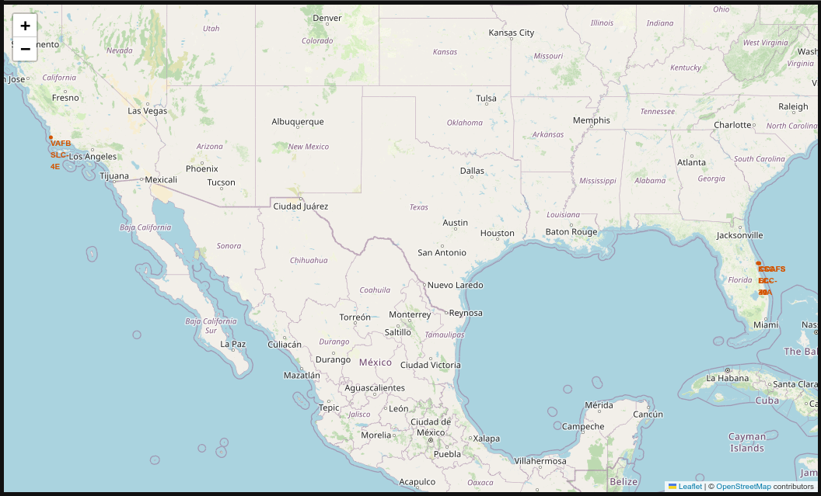
Launch Site Locations
Launch sites are in the proximity of the coastline
Launch sites are located in two regions, one for each coast in the USA

Slide 36
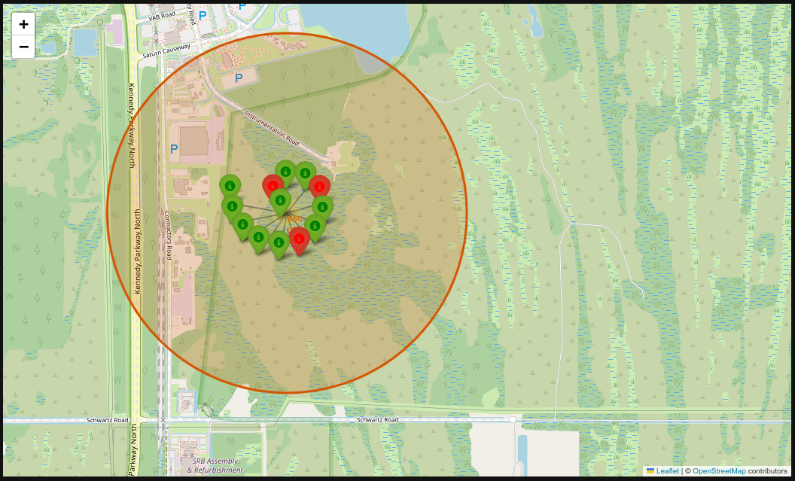
Landing Outcomes for each Launch Site
For each Launch Site a MarkerCluster is added with Landing Outcome
Green/Red marker represents successful/unsuccessful landing
One can see that with increased amount of missions the landings are all successful

Slide 37
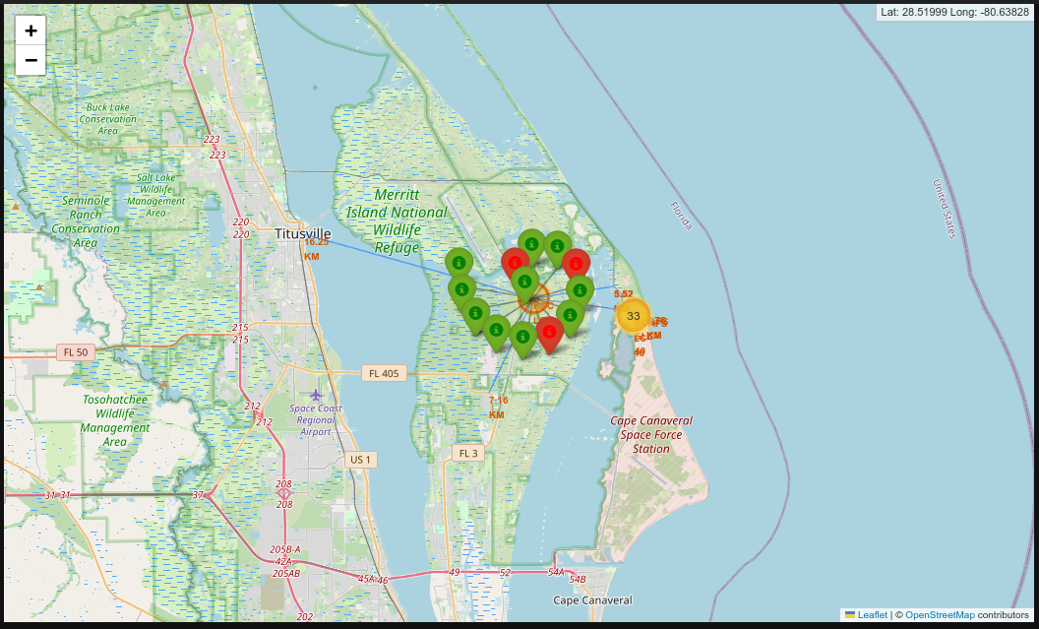
Proximities of KSC LC-39A Launch Site
The distance of KSC LC-39A to the neighboring infrastructures and locations is shown on the map
It can be seen that the nearby city is about 17 km away, while the closest freeway is only 8 km away

Slide 38

Section 4

Slide 39
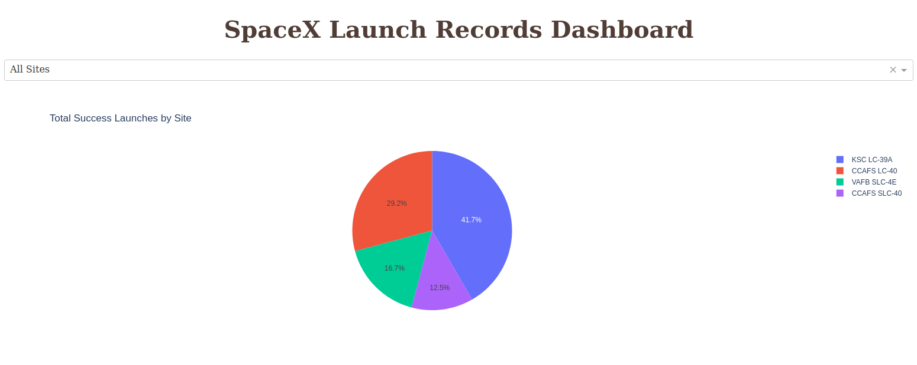
Dashboard: Success Rate for All Sites
The most successful Launch Site, in terms of Landing outcome, is KSC LC-39A

Slide 40
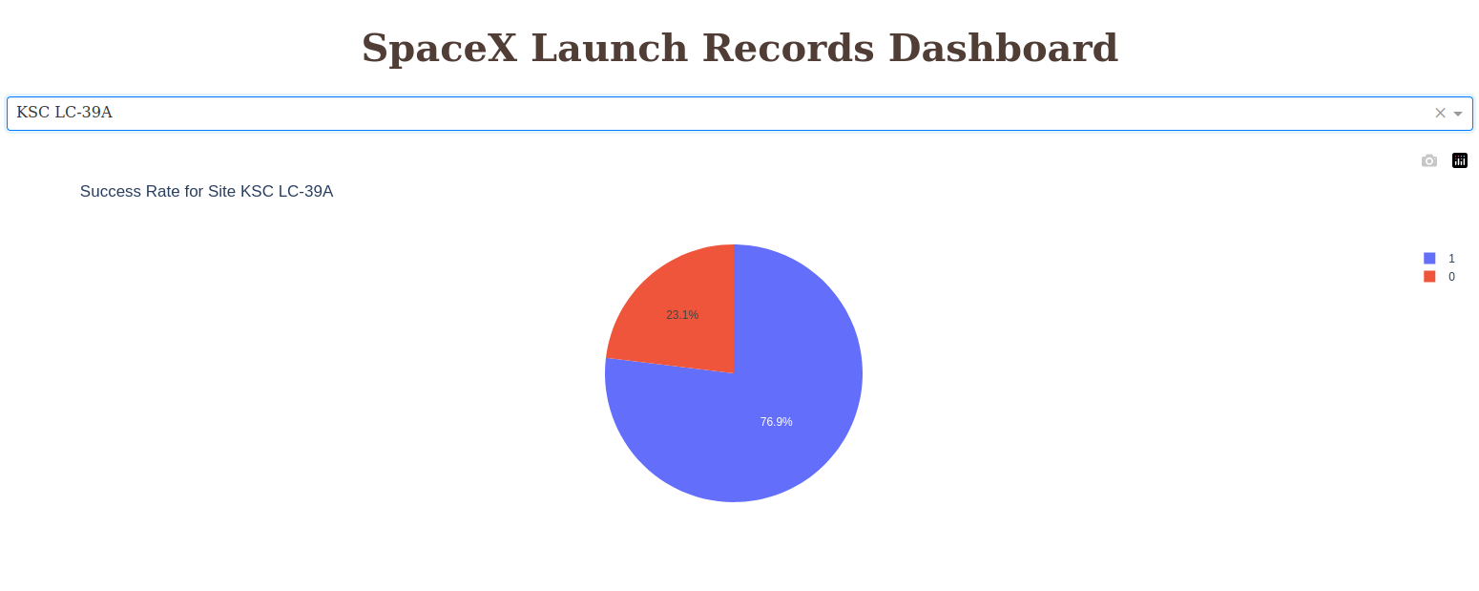
Dashboard: KSC LC-39A Success Rate
The success rate, in terms of Landing outcome, is about 77 %

Slide 41
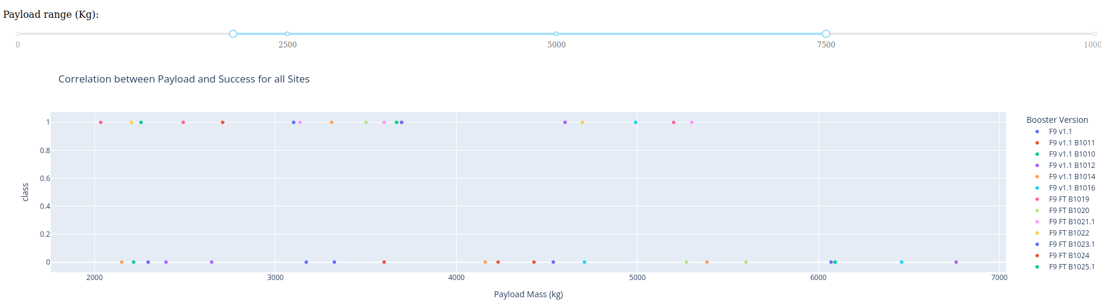
Dashboard: Success Rate for 2000-7000 kg Payload
The least successful landings are correlated with payload in the range 5500 - 7000 kg, where no successful ones are found
The range of 2000 - 4000 kg is the most successful

Slide 42

Section 5

Slide 43
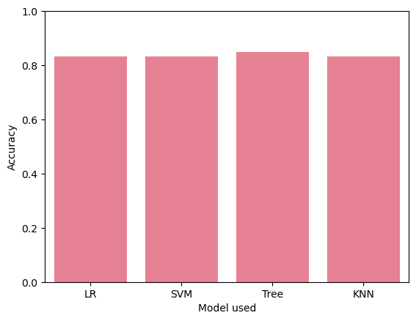
Classification Accuracy
The best Accuracy is found to be for the Classification Tree model and about 85 %
The other models performed identically to each other with 83 %

Slide 44
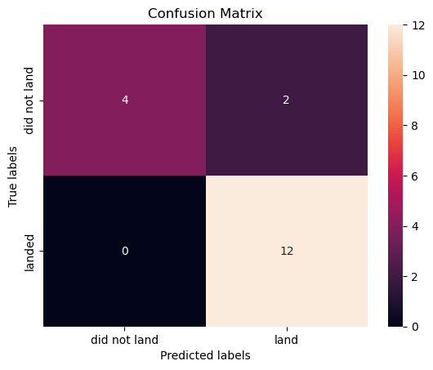
Confusion Matrix
The Classification Tree performed better with True Negatives (4) with respect to the other models (3), thus reducing by one the False Positives (2)
All the models performed identically with respect of True Positives, by predicting correctly all 12 cases

Slide 45
Conclusions
In order to improve the Success rate the following Launch parameters should be adopted:
KSC LC-39A as the Launch Site
A Payload of more than 10000 kg
SSO Orbit Type
During the first three Years of a hypothetically founded company will result in considerable costs due to Landing Failures
Landing Failures serve as Learning material for perfecting the task
A Success Rate of more than 90 % is achievable
If the optimal Launch parameters are not available, a Classification Tree model can be used to predict the outcome of the Landing with 85 % Accuracy

Slide 46
Appendix 1
The Notebooks, python code and Data are available at:
https://github.com/4ipsyki/SpaceY
Note 1: For a better understanding of a long-run costs for such a company, more recent data should be considered, together with the already available ones from 2017 and on

Slide 47
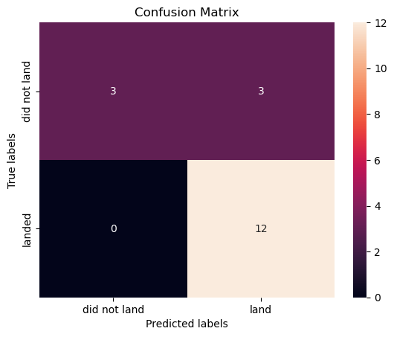
Appendix 2 - Predictive Analysis
Multiple Linear Regression
SVM
The Confusion Matrices for each model are shown on the right:
All the 12 True Positives are correctly predicted
False Positives are 3 for all models except Classification Tree
Classification Tree
KNN

Slide 48


